Slide 1
FA with output

Slide 2
FA with output
Finite automata may have outputs corresponding to each transition. There are two types of finite state machines that generate output −
Mealy Machine
Moore machine

Slide 3
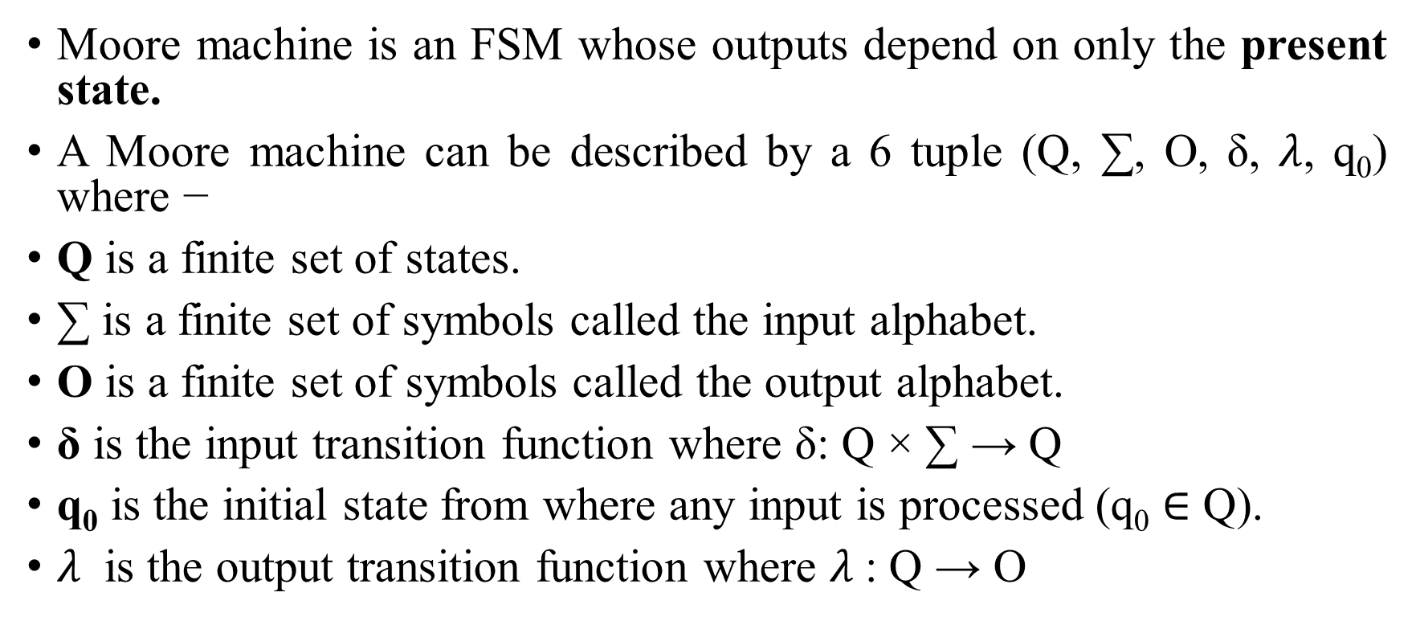
Moore Machine
Moore machine is an FSM whose outputs depend on only the present state.
A Moore machine can be described by a 6 tuple (Q, ∑, O, δ, $λ$, q₀) where −
Q is a finite set of states.
∑ is a finite set of symbols called the input alphabet.
O is a finite set of symbols called the output alphabet.
δ is the input transition function where δ: Q × ∑ → Q
q₀ is the initial state from where any input is processed (q₀ ∈ Q).
$λ$ is the output transition function where $λ$: Q → O

Slide 4
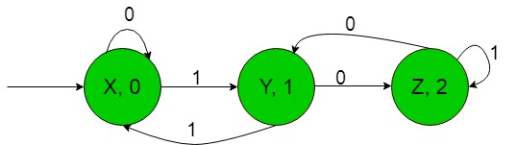
Example

Slide 5
Example of Moore Machine
Create a Moore machine that counts number of a mod3. ∑={a, b}.
b
b
b
q0/0
a
q1/1
a
q2/2
a
Present State | Next State |  | Output
 | a | b
→q0 | q1 | Q0 | 0
q1 | q2 | q1 | 1
q2 | q2 | q1 | 2

Slide 6
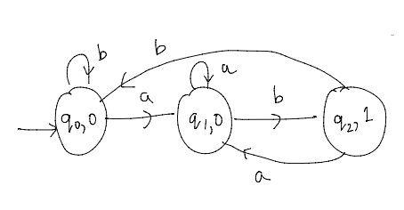
Question-1
Construct a Moore maAchine that takes set of all strings over { a, b} as input and prints 1 as output for every occurrence of ‘ab’ as a substring.

Slide 7
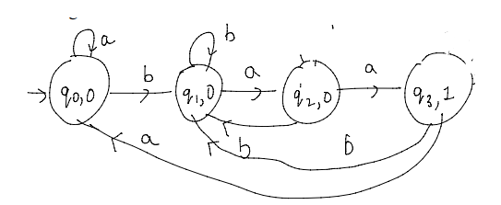
Question-2
Construct a Moore machine that takes set of all strings over { a, b} as input and counts the occurrences of substring ‘baa’.

Slide 8
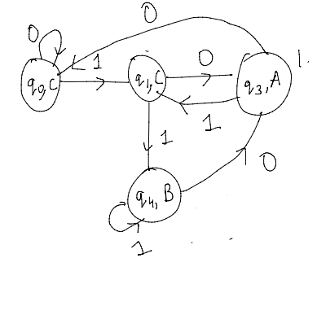
Question-3
Construct a Moore machine that takes set of all strings over { 0,1} as input and produces ‘A’ as output if input ends with ‘10’ , ‘B’ as output if input ends with ’11’, otherwise outputs ‘C’

Slide 9
Question-4
Construct a Moore machine that determines whether an input string contains an even or odd number of 1's. The machine should give 1 as output if an even number of 1's are in the string and 0 otherwise.

Slide 10
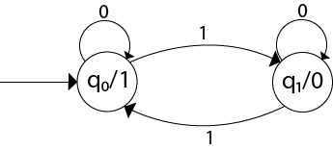
Solution

Slide 11
Question-5
Design a Moore machine for a binary input sequence such that if it has a substring 101, the machine output A, if the input has substring 110, it outputs B otherwise it outputs C.

Slide 12
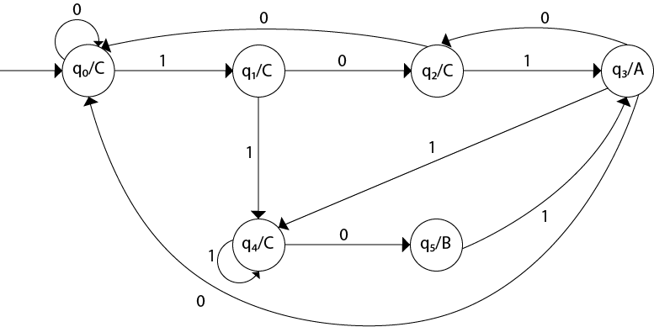
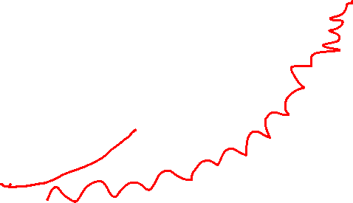
Solution

Slide 13
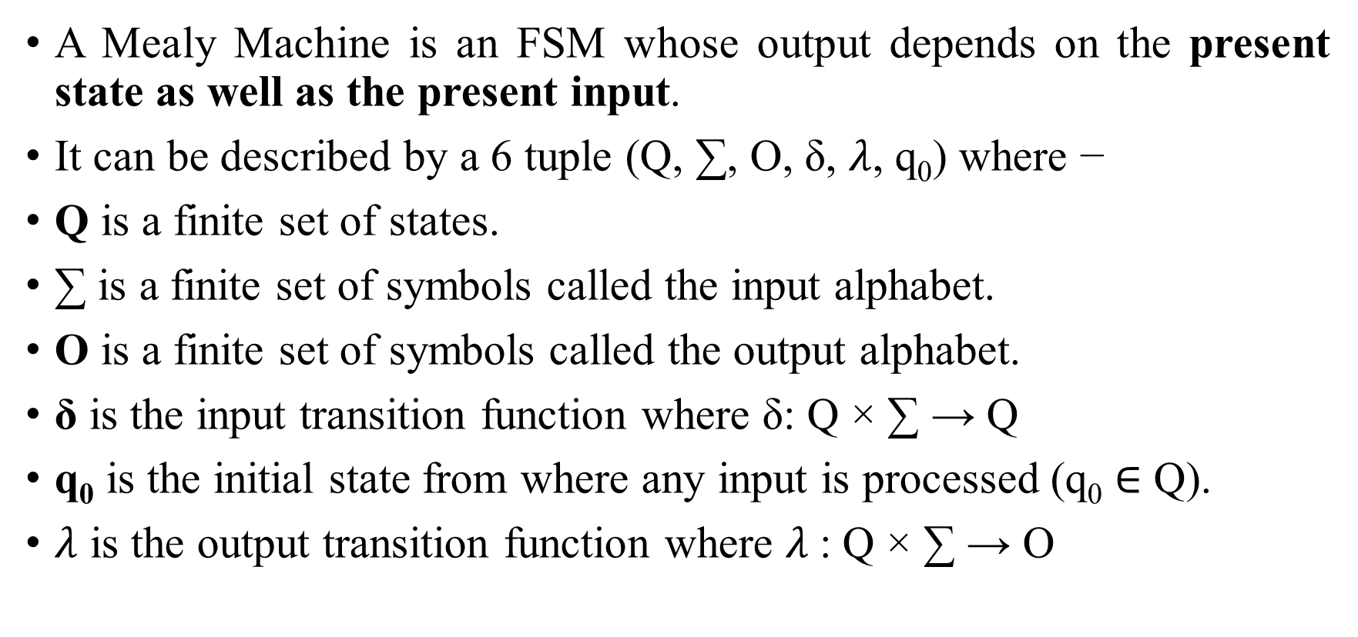
Mealy Machine
A Mealy Machine is an FSM whose output depends on the present state as well as the present input.
It can be described by a 6 tuple (Q, ∑, O, δ, $λ$, q₀) where −
Q is a finite set of states.
∑ is a finite set of symbols called the input alphabet.
O is a finite set of symbols called the output alphabet.
δ is the input transition function where δ: Q × ∑ → Q
q₀ is the initial state from where any input is processed (q₀ ∈ Q).
$λ$ is the output transition function where $λ$: Q × ∑ → O

Slide 14
Example of Mealy Machine
Design a Mealy machine that accepts all strings over ∑={a, b} ending in aa or bb.
a/1
q2
Present State | Next State
 | a | b
→q0 | q2, 0 | q1, 0
q1 | q2, 0 | q1, 1
q2 | q2, 1 | q1,0
a/0
a/0
b/0
q0
b/0
q1
b/1

Slide 15
Mealy Machine | Moore Machine
Output depends both upon the present state and the present input | Output depends only upon the present state.
Generally, it has fewer states than Moore Machine. | Generally, it has more states than Mealy Machine.
The value of the output function is a function of the transitions and the changes, when the input logic on the present state is done. | The value of the output function is a function of the current state and the changes at the clock edges, whenever state changes occur.
Mealy machines react faster to inputs. They generally react in the same clock cycle. | In Moore machines, more logic is required to decode the outputs resulting in more circuit delays. They generally react one clock cycle later.

Slide 16
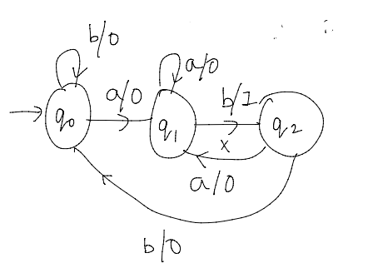
Question-1
Construct a Mealy machine that takes set of all strings over { a, b} as input and prints 1 as output for every occurrence of ‘ab’ as a substring.

